Slide 1
New 4-H Volunteer Orientation
Preparing to Serve as a Certified Oklahoma 4-H Volunteer
Revised 8/2026
Notes:
Using This Presentation
The slide notes provide a suggested script to help presenters build confidence and deliver a clear, consistent statewide message. Presenters may adapt the wording naturally while maintaining the key points.
A recorded version is also available. If using the recording, pause at each Time for County Sharing slide to provide local information, answer questions, and connect the content to your county program.
It will take approximately 60 minutes to conduct a proper orientation. This allows presenters time to establish relationships with volunteers, answer questions, discuss local information, and create a welcoming experience without feeling rushed.
8/2026 https://youtu.be/6w5pIgoCeP8
Purpose
This orientation provides first-time volunteers with a consistent statewide introduction to Oklahoma 4-H, their role, program expectations, and essential policies. Continuing education will help volunteers explore and apply these concepts more fully.
Before the Session
Review the presentation and supporting materials until you are comfortable with the content. Preparation builds presenter confidence and helps ensure volunteers receive consistent information.
Prepare the information and resources needed for the four Time for County Sharing slides.
Allow adequate time for discussion and questions.
During the Session
Welcome participants and invite them to share what brought them to 4-H and how they hope to serve.
Reassure volunteers that they are not expected to remember everything presented.
Emphasize these foundational messages:
4-H provides safe, supportive environments where youth grow alongside caring adults.
Youth–adult partnerships, shared leadership, clear responsibilities, and communication strengthen the program.
Involving more youth, families, and volunteers creates stronger learning experiences and distributes responsibility.
Volunteers should ask questions, seek support, and continue developing their knowledge and skills.
Use the orientation as the first step in building a supportive relationship with each volunteer.

Slide 2
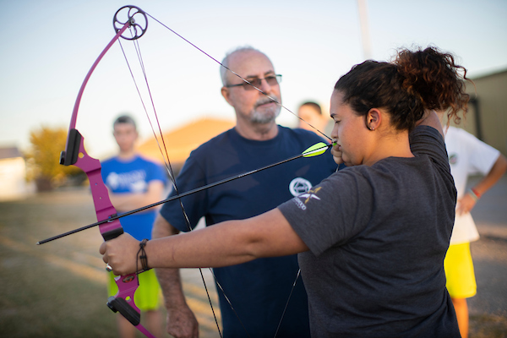
WHY WE CERTIFY VOLUNTEERS
Create safe, positive environments for youth.
Prepare volunteers to serve confidently and effectively.
Clarify responsibilities and protect youth, volunteers, and the Oklahoma 4-H program.
Document sanctioned volunteer service and support limited protection under the Oklahoma Governmental Tort Claims Act.
Provide continuing education in current youth-development practices.
Notes:
Suggested time: 1 minutes.
Volunteer certification is more than completing forms or meeting a requirement. It helps ensure that volunteers understand Oklahoma 4-H, their responsibilities, and the practices that protect both youth and adults.
Certification also establishes volunteers as individuals authorized to serve on behalf of Oklahoma 4-H within an approved role. This documentation may provide limited protection under the Oklahoma Governmental Tort Claims Act when volunteers are acting within the scope of their assigned responsibilities.
Certification is the beginning of the learning process. Continuing education helps volunteers strengthen their skills, remain current, and feel supported throughout their service.

Slide 3
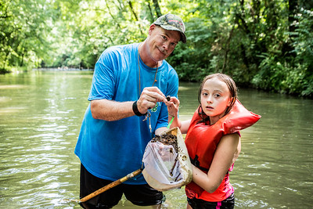
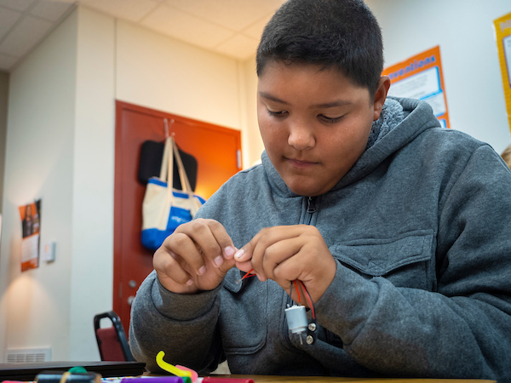
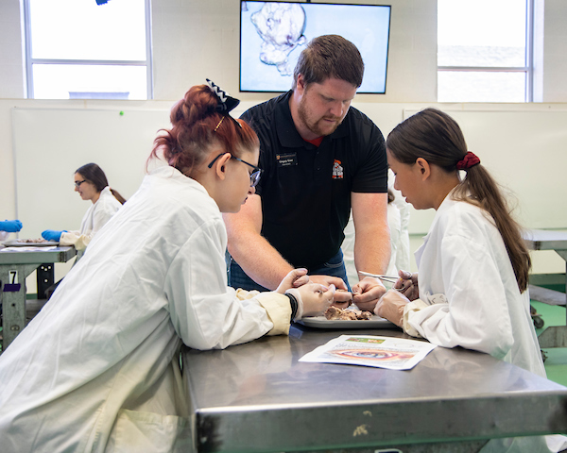
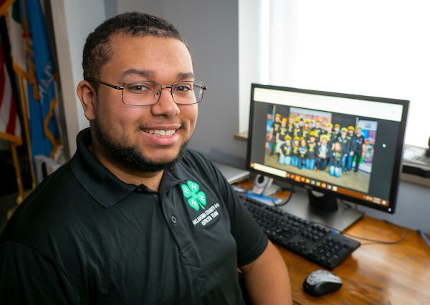
WHO WE ARE…
Oklahoma 4-H is positive youth development education delivered through Cooperative Extension.
Oklahoma’s land-grant institutions:
Oklahoma State University — 1862
Langston University — 1890
College of the Muscogee Nation — 1994
Notes:
Suggested time: 1 minutes.
4-H is the youth-development program of Cooperative Extension. Extension connects the research, knowledge, and resources of land-grant institutions with individuals, families, and communities.
Oklahoma has three land-grant institutions: Oklahoma State University, Langston University, and the College of the Muscogee Nation. Each contributes to positive youth development education in Oklahoma.
The word cooperative reflects the partnership among federal, state, university, and county resources that makes Extension programming possible.
KEY POINT - For volunteers, the important point is that 4-H is an educational program. Our clubs, projects, activities, and events are methods we use to help young people learn and grow.

Slide 4
4-H Youth Development
Notes:
Suggested time: 45 seconds.
Positive youth development focuses on young people’s strengths, interests, and potential. It provides caring relationships, safe environments, meaningful responsibilities, and opportunities to practice and develop skills.
In 4-H, the activity or finished product is important, but it is not the ultimate goal. Raising an animal, giving a speech, creating art, attending camp, or completing a service project provides a setting in which young people can build confidence, make decisions, accept responsibility, and contribute to others.
The next several slides introduce the educational practices volunteers use to make that development intentional.
Facilitator handouts:
4H.VOL.111 Developing 4-H Project Work
4H.VOL.135 Life Skills Definitions
4H.VOL.105 Recognition Model
4H.VOL.118 Experiential Learning

Slide 5


HOW 4-H SUPPORTS POSITIVE YOUTH DEVELOPMENT
4-H provides:
Learning by doing
Caring relationships between youth and adults
Safe, welcoming environments
Opportunities for positive risk-taking
Intentional reflection and progressive learning
Connections to families, communities, and the real world
Healthy
Habits
Building
Capacity
Notes:
Suggested time: 1-2 minutes.
4-H supports positive youth development through experiences in which young people learn by doing. Youth are actively involved in exploring, practicing, making decisions, and solving problems.
Caring relationships are essential. Volunteers provide encouragement, guidance, and support while allowing youth to take increasing responsibility for their own learning.
A safe and welcoming environment gives young people the confidence to try something new. Positive risk-taking might include speaking in front of a group, running for an office, entering a first contest, leading an activity, or attempting a new skill.
4-H learning is intentional and reflective. We help youth think about what they did, what they learned, what they might change, and how they can use that learning in another situation.
Learning is also progressive. Experiences build on one another over time as youth develop greater knowledge, skill, confidence, and responsibility.
Finally, 4-H learning is connected to families, communities, and real-life experiences. Young people are not simply completing activities; they are developing the capacity to use what they learn in other parts of their lives.

Slide 6

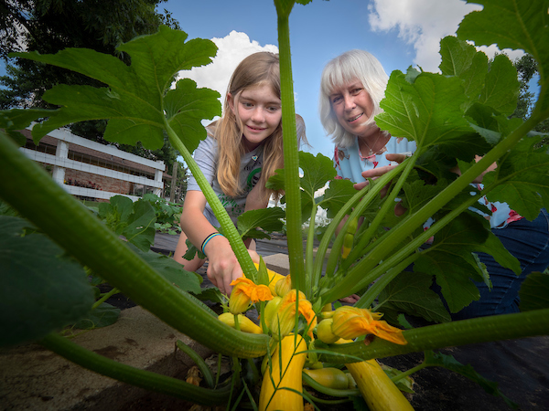
4-H PROJECT WORK: Learning That Grows Over Time
Begins with a young person’s interest or “spark.”
Builds knowledge and skills through goals and practice.
Develops life skills, responsibility, and self-direction.
Connects learning to real life and careers.
Learn by Doing
Notes:
Suggested time: 1-2 minutes.
Project work is one of the primary ways young people learn in 4-H. It begins with a young person’s interest or “spark” and provides opportunities to set goals, practice skills, make decisions, and see progress over time.
There is a difference between project work and a project. Project work is the larger subject area a member explores, such as foods, horticulture, photography, animal science, or public speaking. A project is one specific experience or product completed within that subject area, such as preparing a meal, growing a garden, taking a photograph, or giving a speech.
One activity, contest, or finished product does not represent the full project-learning experience. Mastery develops through continued learning and repeated practice.
Project work should be age-appropriate and flexible enough to match each member’s interests, abilities, and goals. As members gain experience, they can take greater responsibility for planning and directing their own learning.
Volunteers do not have to be experts in every project area. Their role is to encourage curiosity, help members locate resources, provide opportunities to practice, and ask questions that help youth recognize what they are learning.
Through project work, young people develop subject-matter knowledge while also building life skills such as goal setting, decision-making, self-motivation, responsibility, and learning to learn.

Slide 7
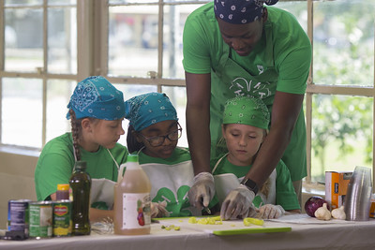
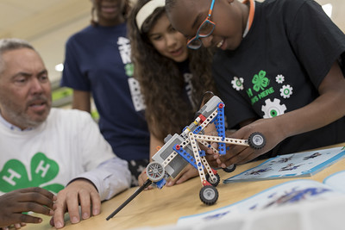
PROJECTS, EVENTS AND ACTIVITIES
Different Experiences—Different Purposes
  Project Work
  Builds knowledge, skills, and life skills over time.
  Events
  Provide education, evaluation, and recognition.
  Activities
  Provide education, participation, and fellowship.
Notes:
Suggested time: 1-2 minutes.
Project work, events, and activities are all important parts of 4-H, but they serve different purposes.
Project work is the ongoing learning a member completes within a subject area. It includes setting goals, gaining knowledge, practicing skills, and applying what is learned over time.
Events provide education and may include evaluation and recognition. Examples include a speech contest, judging event, fair, or project exhibition. Events give members an opportunity to demonstrate what they have learned and receive feedback.
Activities emphasize education, participation, and fellowship. Examples include a workshop, tour, recreation activity, service project, or club celebration.
Events and activities support project work, but they do not replace it. Entering one contest, attending one workshop, or completing one exhibit is only one part of the larger learning experience.
The finished product, ribbon, or placing is not the ultimate goal. The greater purpose is the growth that occurs as the young person learns, practices, makes decisions, evaluates progress, and applies what was learned.

Slide 8
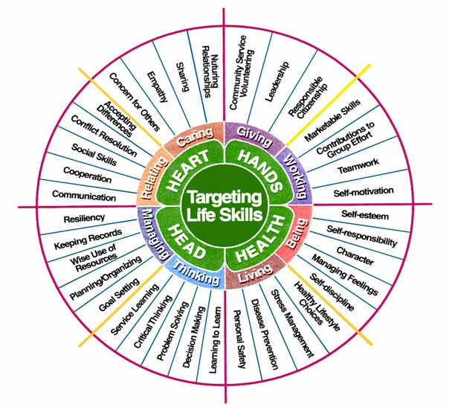
4-H Life Skills Model
Head — Thinking and Managing
  Goal setting
  Learning to learn
Heart — Relating and Caring
  Cooperation
  Social skills
Hands — Giving and Working
  Contributions to group efforts
  Self-motivation
Health — Living and Being
  Self-esteem
  Self-responsibility
Help Sheet: 4H.VOL.135 Life Skills Definitions
Notes:
Suggested time: 1-2 minutes.
Life skills are the abilities young people need to manage their lives, work with others, make decisions, and contribute to their families and communities.
The 4-H Life Skills Model organizes these skills under Head, Heart, Hands, and Health. The slide provides two examples from each area, but the complete model includes many additional life skills.
Life skills develop alongside subject-matter skills. For example, a member preparing a speech may develop communication skills, goal setting, self-motivation, and confidence. A member participating in a service project may develop cooperation, responsibility, planning, and contributions to group efforts.
These skills do not develop automatically simply because a young person participates in an activity. Volunteers help make life-skill development intentional by deciding which skills an experience can strengthen and helping youth reflect on what they learned.
The Life Skills Definitions help sheet provides consistent definitions. Volunteers should use it rather than assuming that everyone interprets terms such as leadership, responsibility, or decision-making in the same way.
Over the course of a member’s 4-H experience, provide a variety of opportunities that develop skills across all four areas: Head, Heart, Hands, and Health.

Slide 9

4-H Recognition Model
Participation in educational experiences.
Making progress toward self-set goals.
Achieving standards of excellence.
Excelling in peer competition.
Demonstrating excellence in cooperation.
Progress Toward Self-Set Goals
Participation
Cooperation
Peer Competition
Standards
of Excellence
A club and county program should have a healthy blend of all five forms of recognition.
Help Sheet: 4H.VOL.105 Recognition Model
Notes:
Suggested time: 1-2 minutes.
Recognition encourages young people to participate, continue learning, and take pride in their growth. In 4-H, recognition is much broader than earning a ribbon or placing first in a competition.
The Recognition Model includes five equally important forms.
Participation recognizes a young person for becoming involved and completing an educational experience. For some youth, joining a group, attending an activity, or trying something new is a significant accomplishment.
Progress toward self-set goals recognizes individual growth. Members identify something they want to learn or improve and are recognized for the progress they make toward that goal.
Standards of excellence compares a member’s work with established criteria rather than with another person. The blue, red, and white ribbon or Danish system is one familiar example.
Peer competition compares a member’s performance or product with others. Volunteers prepare youth by reviewing expectations, setting realistic goals, and emphasizing effort and sportsmanship. Afterward, help members reflect on what they learned and what they want to improve. A placing is one result—it does not define the young person’s value or ability.
Cooperation recognizes young people for working together and contributing to a shared goal. It reinforces teamwork, shared responsibility, and the value of everyone’s contribution.
A healthy 4-H program uses all five forms. When recognition focuses only on competition, many important accomplishments can be overlooked. Volunteers should also recognize participation, personal progress, skill development, cooperation, and effort.
The goal is to help every young person see that growth and contribution matter—not only winning.

Slide 10

4-H Experiential Learning Model
1. Experience the activity: perform, do it
Developed by Kolb (1984) and modified by 4-H
5.
Apply what was learned to a similar or different situation; practice
Do
2.
Share the results, reactions, & observations openly
Learning happens through experience, reflection and application.
Apply
Reflect
4. Generalize to connect the experience to real world examples
3.
Process by discussing, looking, analyzing and reflecting the experience
Help Sheet: 4H.VOL.118 Experiential Learning
Notes:
Suggested time: 1-2 minutes.
The 4-H Experiential Learning Model explains how “learning by doing” becomes meaningful learning. Completing an activity is only the beginning. Youth also need opportunities to reflect on the experience and apply what they learned.
The model includes five steps.
First, youth experience the activity by doing it.
Second, they share what happened, including their observations and reactions.
Third, they process the experience by considering what worked, what was challenging, and why the results occurred.
Fourth, they generalize by connecting the experience to other situations in their lives.
Finally, they apply what they learned to a new or similar experience.
Volunteers guide this process by asking open-ended questions. These might include:
What happened?
What was easy or difficult?
What did you learn?
Where else could you use this skill?
What would you do differently next time?
Without reflection, a young person may complete an activity without recognizing the larger learning. The volunteer’s questions help youth identify the knowledge and life skills they developed and consider how to use them again.
The cycle continues as youth apply what they learned, try again, reflect, and improve. This is how 4-H experiences build mastery over time.

Slide 11

4-H PLEDGE
I pledge
My head to clearer thinking,
My heart to greater loyalty,
My hands to larger service, and
My health to better living for my club, my community, my country, and my world.
Notes:
Suggested time: 1 minutes.
The ideas we have discussed—learning, relationships, service, responsibility, and applying skills to life—are reflected in the four H’s and in the 4-H Pledge.
Head represents clearer thinking, learning, decision-making, and managing our responsibilities.
Heart represents loyalty, caring, positive relationships, and respect for others.
Hands represent service, work, skill development, and contributing to a group or community.
Health represents physical, emotional, and social well-being and making responsible choices.
The final line—“for my club, my community, my country, and my world”—reminds us that 4-H learning extends beyond the individual. Young people are encouraged to use what they learn to contribute to others.
The pledge is more than something recited at a meeting. It summarizes the values we are working to develop through 4-H experiences.

Slide 12

USING THE 4-H NAME AND EMBLEM
Using the 4-H Name and Emblem
Write the name correctly: 4-H
Use an official emblem provided by Extension.
Use the complete emblem without altering it.
When in doubt, contact the county Extension office.
Notes:
Suggested time: 1 minute.
The official name is written as the numeral 4, followed by a hyphen and a capital H. The hyphen should not be replaced with a dash, slash, or space.
The official emblem is a green four-leaf clover with a white letter “H” in each leaf and the stem turned to the right. Always use an official emblem file provided by Extension.
The emblem must be used in its entirety and may not be altered. Do not crop it, cover it, rotate it, change its proportions, add images or words over it, or redesign it for a club, activity, or event.
Before creating signs, clothing, promotional items, fundraising materials, or other products using the 4-H Name or Emblem, check with the county Extension office. When uncertain, ask before producing or purchasing the item.
The purpose of these guidelines is to protect the 4-H identity and ensure that the name and emblem are used consistently and appropriately.
[Sources- 8/2026] - USDA National Institute of Food and Agriculture, “4-H Name, Emblem and Pledge,” updated December 1, 2025: https://www.nifa.usda.gov/4-h/national-headquarters/program-quality-accountability/name-emblem-pledge [/Sources]

Slide 13


A Time for County Sharing
Explore 4-H Opportunities in Our County
Show and explain:
  Community and project clubs
  Available project materials and resources
  County activities and events
  How members register or enter
  Recognition and awards
Notes:
Pause Here to Explore 4-H Opportunities in Our County
Customize this slide before the orientation. Use current county terminology, contacts, links, resources, and procedures. Have the actual resources available to show/give participants.
County Connection 1 – Local Opportunities
Show: Project curriculum/materials, club listings, activity and event information, entry forms, and recognition resources.
Explain: How members access project materials, participate in clubs, register for activities and events, and receive evaluation and recognition.
Connect: Ask the volunteer which projects, activities, or events relate to their interests, skills, or volunteer responsibilities.

Slide 14
Maintaining
Volunteer Certification
Notes:
Suggested time: 15 seconds.
Certification is not a one-time process. It begins with screening and orientation and continues through annual renewal, policy reviews, continuing education, and periodic background checks.

Slide 15


MAINTAINING CERTIFICATION
CONTINUING EDUCATION OPPORTUNITIES
Each year
Re-enroll through ZSuite.
Renew Working with Minors.
Renew Respecting Civil Rights.
Complete at least four continuing education credits/trainings
  At least two should be county-level with Extension staff.
Every four years
Complete a new background check, or sooner if required.
Important: The renewal of WWM and Civil Rights do not count toward the four trainings.
County training
Conferences and live webinars
Project-specific training
ZSuite Clover Academy
Other training approved by county Extension staff
https://www.facebook.com/ok4hvolunteersandparents
Notes:
Suggested time: 1 minute.
Each year, certified volunteers must renew Working with Minors, and Respecting Civil Rights, and participate in at least four continuing education trainings. These are separate requirements. The annual renewal of Working with Minors and Respecting Civil Rights do not count toward the four continuing education trainings.
At least two continuing education trainings should be completed at the county level with Extension staff. These opportunities build relationships, provide county-specific information, and give volunteers time to ask questions and discuss local needs, resources, procedures, and expectations. The remaining trainings may be completed through other approved county, district, state, regional, national, online, project-specific, or outside opportunities.

Slide 16
Program Policy & Guidelines
Notes:
Suggested time: 15 seconds.
Download a copy of the Oklahoma 4-H Rules and Guidelines located in ZSuite or on the Oklahoma 4-H Webpage.
Handout:
Oklahoma 4-H Rules and Guidelines

Slide 17
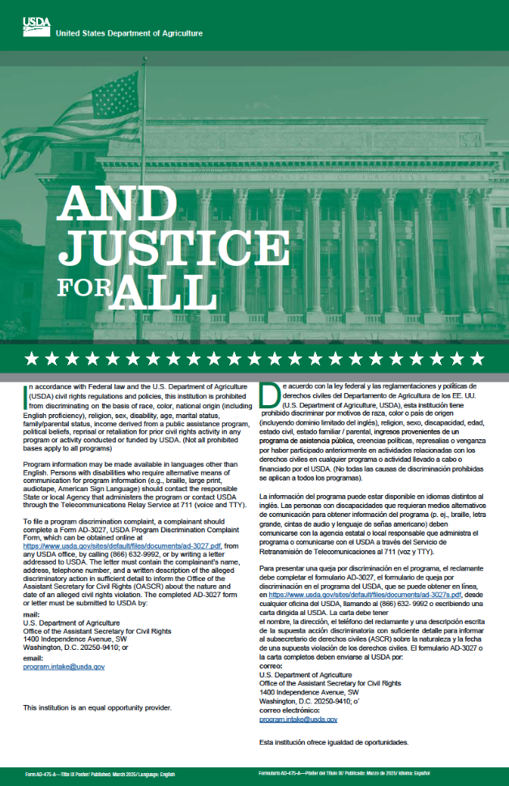

AFFIRMATIVE ACTION
Oklahoma State University, as an equal opportunity employer, complies with all applicable federal and state laws regarding non-discrimination. Oklahoma State University is committed to a policy of equal opportunity for all individuals and does not discriminate based on race, religion, age, sex, color, national origin, marital status, disability or veteran status with regard to employment, educational programs and activities, and/or admissions. For more information, visit https://eeo.okstate.edu. (5/2025)
Notes:
Suggested time: 1 minute.
Oklahoma 4-H is committed to providing equal access to educational programs and activities.
As volunteers, we carry out this commitment by creating environments where youth and adults feel welcomed, respected, safe, and included. We do not exclude or treat individuals differently based on personal characteristics protected by university, state, or federal policy.
Volunteers should:
Share information broadly and invite eligible individuals to participate.
Avoid practices that create unnecessary barriers.
Treat participants and families consistently and respectfully.
Work with the Extension educator when an accommodation or additional support may be needed.
Report concerns involving discrimination, harassment, or unequal treatment to Extension staff.
Volunteers are not expected to interpret civil-rights law or resolve concerns alone. Contact the Extension educator when questions or concerns arise.
The required annual Respecting Civil Rights review provides additional information about these responsibilities.

Slide 18
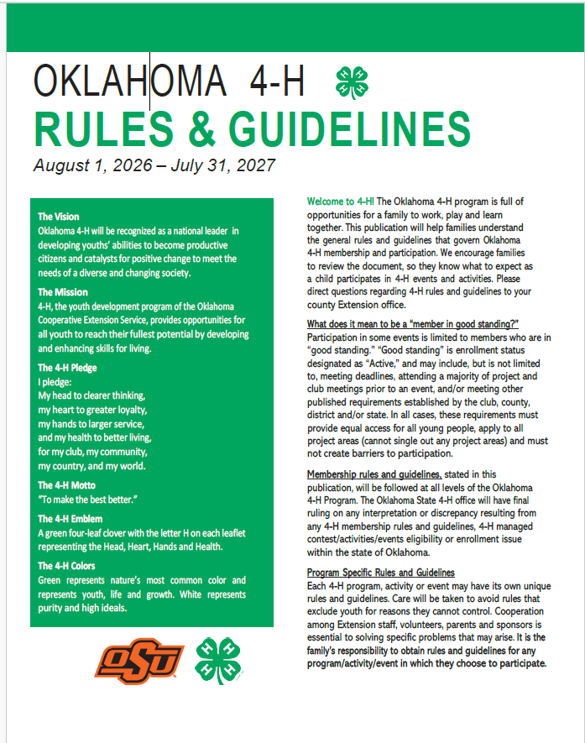
Oklahoma 4-H Rules & Guidelines
Always Refer to the Current Oklahoma 4-H Rules & Guidelines
Available online and through ZSuite; all enrolled families have access.
Key membership reminders
The 4-H year is August 1–July 31.
Eligibility is based on age and grade as of September 1.
Cloverbuds participate in a noncompetitive program.
Enrollment and the program fee must be completed for active membership.
Youth and adult volunteers agree annually to the 4-H Code of Conduct.
Each activity and event may have additional guidelines.
Notes:
Suggested time: 1-2 minutes.
The Oklahoma 4-H Rules and Guidelines is the primary reference for statewide membership and participation policies. Because it is updated regularly, always use the current version rather than relying on memory, an older printed copy, or the way something was handled in a previous year.
The current Rules and Guidelines is available online and through ZSuite, and all enrolled families have access to it.
The 4-H year is August 1 through July 31. Membership eligibility is based on age and grade as of September 1. Cloverbuds participate in a noncompetitive program. Enrollment and the program fee must be completed for a youth to be considered an active member. Youth and adult volunteers also agree annually to follow the 4-H Code of Conduct.
Each 4-H activity and event may have additional eligibility requirements, deadlines, and participation guidelines. Livestock shows, contests, camps, conferences, and other events may operate under rules specific to that experience. School academic-eligibility requirements must also be followed.
Oklahoma 4-H supports membership in other youth organizations. When youth participate in more than one organization, families are responsible for understanding and following the rules of each organization.
Families are responsible for obtaining and following the current guidelines for activities and events they choose to enter. Volunteers and Extension staff help families locate the information and understand how it applies.
Completing an entry or animal nomination form does not necessarily complete 4-H enrollment. When questions arise about enrollment, eligibility, deadlines, or participation requirements, contact the county Extension office.
Do not guess, rely on an old copy, or say, “That is how we have always done it.” Check the current Rules and Guidelines or contact the Extension office.

Slide 19
Time for County Sharing
Know Where to Find Current Information
Show and explain:
  County yearbook or family guide
  Newsletter and communication methods
  Calendar, deadlines, and forms
  County and state 4-H websites
  ZSuite announcements, shared forms, calendars
  Who to contact with questions
Notes:
Pause Here to learn where to find current information in our county.
Customize this slide before the orientation. Use current county terminology, contacts, links, resources, and procedures. Have the actual resources available to show participants.
County Connection 2 – Information and Communication
Show: The county yearbook or family guide, newsletter, calendar, forms, ZSuite, county website, and other communication tools.
Explain: Where current information is posted, how often communication is distributed, which deadlines are most important, and whom volunteers should contact with questions.
Connect: Confirm that the volunteer knows where to find current information and how the county will communicate with them.

Slide 20
How 4-H Is Organized Locally
Notes:
Suggested time: 30 seconds. Advance each element as it is explained.
The next several slides explain how local clubs and the county 4-H program are organized.
The exact names and structure may differ from one county to another, but the basic principle is shared leadership. Youth, families, volunteers, committees, and Extension staff work together to provide educational opportunities.
The goal is not to memorize an organizational chart. The goal is to understand how responsibilities can be divided so that more people contribute and no one person or family is expected to carry the entire program.
We will begin with the local club and then look at how local clubs connect with the county 4-H program.

Slide 21
LOCAL 4-H CLUB STRUCTURE
Continuing Education – leadership, life skills, subject matter, systems management
Public Speaking
County Activity Committees
Committees w/designated Activity Leaders
Share the Fun
4-H Member +
4-H Families +
Parents/Guardians + Teen Leaders +
Certified Adult + Volunteers =
4-H Camp
STEM
County Project Leaders
Project Groups w/Project Leaders
Health
Community or Project Club
Officers/Advisory Group/Club Leader
County PVA and/or County Officers, Teen Leaders
Executive Committee
Committee Chairs
Notes:
Suggested time: 3 minutes.
A local 4-H club begins with its members and the people who support them: families, parents and guardians, teen leaders, and certified adult volunteers. Each person brings something valuable to the club.
A strong club is not operated by one leader or one family. It develops when youth and adults share responsibility.
[Click] Community or Project Club
Together, these individuals form either a community club offering multiple project areas or a project club focused on a particular subject.
Regardless of the type, the club should provide an organized, safe, welcoming, and educational experience for youth and families.
[Click] Executive Committee
The executive committee provides leadership for the club’s business and planning. It generally includes the youth officers, with guidance from the club leader.
The committee helps prepare meeting agendas, follow up on decisions, and coordinate the work of the club between meetings.
[Click] Project Groups with Project Leaders
Project groups provide members with additional opportunities to develop knowledge and skills in a specific subject area.
One monthly club meeting is generally not enough time for meaningful project work. Project leaders may provide workshops, demonstrations, tours, practice sessions, or a series of project meetings.
[Click] Committees with Designated Activity Leaders
Committees plan and carry out club activities. An activity leader guides the committee, but youth and adults share responsibility for making decisions and completing the work.
Committees divide responsibilities into manageable pieces and allow more members, families, and volunteers to contribute.
[Click] Officers/Advisory Group/Club Leader and Committee Chairs
Youth officers, the club leader, and committee chairs coordinate the different parts of the club program.
The club leader guides and supports youth leadership rather than doing the work for them. Committee chairs communicate plans, involve others, and report progress back to the club.
[Click] STEM and Health
Project groups might focus on subject areas such as STEM or health. The topics offered will depend on member interests and the knowledge and skills available among volunteers, families, and community partners.
[Click] Public Speaking, Share-the-Fun, and 4-H Camp
Committees may also plan or support activities such as public speaking, Share-the-Fun, camp, community service, recreation, or other club and county experiences.
These activities provide additional opportunities for youth to participate, practice skills, and develop leadership.
[Click] County PVA and/or County Officers and Teen Leaders
The local club is connected to the larger county 4-H program.
Parent-volunteer groups, county officers, youth councils, and teen leaders provide opportunities for local clubs to participate in county planning and leadership.
[Click] Connector
These county groups help connect local clubs with county resources, leaders, activities, and events.
[Click] County Project Leaders
County project leaders provide subject-matter learning opportunities that may not be available within every local club. They may conduct workshops, project groups, clinics, or other educational experiences for members throughout the county.
[Click] County Activity Committees
County activity committees bring youth and adults together to plan, conduct, and evaluate county activities and events.
Local volunteers and families can serve on these committees without being responsible for coordinating an entire county program.
[Click] Continuing Education
Extension educators provide continuing education to help volunteers strengthen their leadership, life-skills knowledge, subject-matter expertise, and understanding of 4-H program management.
Volunteers are not expected to know everything when they begin. Training, resources, and support should continue throughout their service.
Closing point
This structure distributes leadership and responsibility. When more youth, families, and volunteers become involved, the club can offer stronger learning experiences without expecting one or two people to carry the entire program.

Slide 22
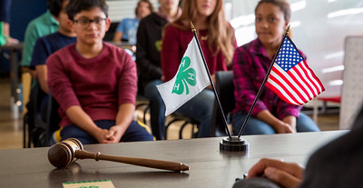


A STRONG 4-H CLUB IS YOUTH-LED AND ADULT-SUPPORTED
A strong 4-H club:
Provides a safe, welcoming, and enjoyable environment.
Meets regularly and communicates with families.
Is led by youth with guidance from caring adults.
Includes education, recreation, and business.
Develops project, leadership, and communication skills.
Recognizes participation, progress, cooperation, and achievement.
50% Education
33% Recreation
17% Business
Notes:
Suggested time: 2-3 minutes.
A 4-H club is more than a group that holds meetings. It is an educational environment where young people practice leadership, develop relationships, explore interests, and learn to take responsibility.
A strong club should be safe, welcoming, and enjoyable for members and their families. Young people are more likely to participate and continue in 4-H when they feel that they belong and that their ideas and contributions are valued.
The club should meet regularly and communicate clearly with families. Families need to know when and where the club meets, what is planned, what members should bring, and how they can become involved.
A 4-H club is youth-led and adult-supported. Youth officers and committees should have meaningful responsibilities. Caring adults teach, guide, and encourage them without taking over or doing the work for them.
This does not mean that youth are expected to know automatically how to run a meeting or lead an activity. Adults prepare them, provide age-appropriate instruction, and help them reflect on what worked and what they might do differently next time.
Meeting balance
A helpful guideline is for a club meeting to include approximately:
50 percent education
33 percent recreation
17 percent business
For a one-hour meeting, that would be approximately 30 minutes of education, 20 minutes of recreation and fellowship, and 10 minutes of business.
This is a guideline—not a rigid formula for every meeting. Its purpose is to keep business from consuming the entire meeting and to ensure that members have opportunities to learn, interact, and have fun.
Education might include a demonstration, project lesson, guest speaker, tour, or hands-on activity. Recreation can include games, team-building, refreshments, or opportunities for members to visit and build relationships.
Skills and recognition
Strong clubs intentionally provide opportunities for members to develop project skills, leadership, communication, cooperation, decision-making, and responsibility.
Leadership is not limited to elected officers. Members can lead pledges, give reports, serve on committees, teach an activity, welcome visitors, or help plan a club experience.
Recognition should also extend beyond winning. Clubs should recognize participation, progress toward personal goals, cooperation, skill development, and achievement.
Charter
A recognized 4-H club is chartered. The charter identifies the group as an official 4-H club authorized to use the 4-H name and emblem.
Each year, the club completes a self-assessment with the county Extension educator to review its work and renew its charter. The purpose is to help the club reflect, celebrate progress, and plan for continued growth.
Closing point
The goal is not to create a perfect meeting. The goal is to create a club where youth gradually assume greater responsibility while caring adults provide the preparation, encouragement, and support they need to succeed.

Slide 23
COUNTY 4-H
PROGRAM STRUCTURE
Club
PVA
Youth Leaders
PAC
Executive
Activity
Event
Project Leaders
Fund Raising
The structure is similar to the Local/Project Club.
Camp
CE
Public Speaking
Share the Fun
Public Speaking
Arts
Disbursement
Activity
Fair
Awards
Horse Show
STEM Fair
Dog
Foods
Donors
ETC.
ETC.
ETC.
Extension Educator
Continuing Education, Management , Delivery Systems
Notes:
Suggested time: 4 minutes.
The county 4-H program uses a leadership structure similar to the local club. The exact names and organization may differ by county, but the purpose is the same: to involve youth and adults in planning, delivering, and supporting the county program.
[Click] Club
Strong local and project clubs form the foundation of the county 4-H program. Club members, families, teen leaders, and volunteers provide the people, ideas, and energy needed for county programming.
[Click – connector]
Local clubs are connected to the county leadership groups. These groups help clubs communicate, share resources, and participate in county planning.
[Click] Parent-Volunteer Association
The Parent-Volunteer Association, or PVA, is comparable to a school’s PTA or PTO. It provides a way for parents, volunteers, club leaders, and other interested adults to assist with the county 4-H program.
The PVA may help identify needs, coordinate committees, support county activities, and strengthen communication between families, volunteers, and Extension staff.
Any interested 4-H adult may participate. People do not necessarily have to hold an elected office to attend meetings or serve on committees.
[Click] Youth Leaders
The county youth leadership group represents the interests and ideas of 4-H members. Depending on the county, it may be called the Youth Council, County Officers, Ambassadors, or Teen Leaders.
Youth leaders help plan county programs, serve on committees, communicate with local clubs, and practice leadership beyond the club level.
The youth leadership group and PVA should work as partners. Youth and adults each bring different experiences and perspectives to county planning.
[Click] Program Advisory Committee
The Program Advisory Committee, or PAC, provides broader guidance to the Extension educator.
Its members represent different communities, experiences, backgrounds, and perspectives. They help identify emerging needs and trends affecting youth and advise Extension on program priorities.
The PAC is different from the PVA. The PVA is actively involved in supporting and conducting the 4-H program, while the PAC provides broader program direction and community perspective.
[Click] Executive, Activity, Event, Project Leaders, and Fundraising
These leadership groups are translated into specific areas of work.
The executive group coordinates meetings and follows up on organizational decisions.
Activity committees plan experiences that emphasize education, participation, and fellowship.
Event committees plan experiences that may include education, evaluation, and recognition.
Project leaders provide subject-matter instruction and opportunities for members to develop skills over time.
The fundraising group helps secure and manage resources needed to support county programming.
Youth and adults should work together on these committees whenever appropriate.
[Click – connectors]
The lines illustrate how county leadership groups support the committees, project leaders, activities, and events that deliver the county program.
Responsibility should not rest entirely with the Extension educator or a small number of volunteers.
[Click] Examples of Activities - Camp, Fair, Continuing Education, Awards, and Other Activities
County activity committees may coordinate experiences such as camp, fairs, volunteer continuing education, awards programs, recreation, service projects, or other county activities.
The examples will vary based on the county program.
[Click] Examples of Events - Public Speaking, Horse Show, Share-the-Fun, STEM Fair, and Other Events
Event committees may coordinate public speaking, Share-the-Fun, livestock or horse events, STEM fairs, judging opportunities, and other educational or competitive events.
Each committee should understand its responsibilities, deadlines, rules, available resources, and relationship with the Extension office.
[Click] Examples of Project Leaders - Public Speaking, Dog, Arts, Foods, and Other Project Areas
County project leaders extend learning beyond what may be available in an individual club.
They may provide workshops, project groups, demonstrations, practices, tours, or a series of learning experiences in subjects such as public speaking, dog projects, arts, foods, STEM, animal science, or other areas.
[Click] Examples of Fund-Raising groups Disbursement, Activities, and Donors
Some counties have a separate 4-H foundation or fundraising organization. In other counties, fundraising may be coordinated through a committee.
These groups may cultivate donors, raise funds for specific activities, and distribute resources according to approved plans.
Fundraising groups support the educational program; they do not determine the program’s educational direction.
[Click] Extension Educator
The Extension educator provides guidance and support across the entire structure. Responsibilities include volunteer continuing education, program management, communication, policy interpretation, and educational delivery systems.
The educator’s role is not to personally plan and conduct everything. The educator prepares and supports youth and adult leaders so they can assume meaningful responsibilities within the county program.
Closing point
Not every county will use every part of this model or use the same terminology. The important principles are shared leadership, clear responsibilities, youth-adult partnership, and communication among local clubs, county groups, volunteers, and Extension staff.

Slide 24
Finding Your Place
Find Your Place in the County
4-H Program
Show and explain:
Youth Council or county youth leadership
Parent-Volunteer Association
Activity and event committees
Project-leader opportunities
Program Advisory Committee
Fundraising or 4-H Foundation
Notes:
Pause Here to find your place in the county 4-H program.
County Connection 3 – County Leadership
Show: The county leadership structure, meeting information, committee opportunities, and current youth and adult leadership groups.
Explain: How the Youth Council, Parent-Volunteer Association, committees, project leaders, Program Advisory Committee, and fundraising groups support the county program.
Connect: Ask where the volunteer’s interests, experience, skills, or community connections might strengthen the county program.

Slide 25
Managing Risk
Approved Roles • Planning • Transportation • Supervision
Notes:
Suggested time: 30 seconds.
Presenter preparation
Review the current Working with Minors requirements, risk-management forms, and county procedures before presenting this section.
Have current copies or links available for:
Form 5 – Non-Certified Adult Volunteer form
Form 7 – Activity and Event Intent
Form 8 – Incident and Accident Report
Transportation and chaperone position descriptions
County insurance and emergency procedures
Risk is present whenever we conduct activities, transport participants, or supervise youth. We cannot eliminate every possibility of an accident or concern, but we can plan carefully, follow established procedures, and respond appropriately.
Working with Minors provides the complete expectations for working with and supervising youth. This section reinforces several practical reminders related to approved volunteer roles, activity planning, transportation, supervision, and reporting.
These practices help protect youth, volunteers, families, and the Oklahoma 4-H program. When responsibilities or procedures are unclear, contact the county Extension office before proceeding.

Slide 26
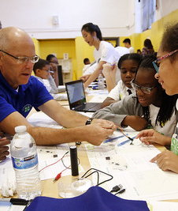
WHEN SERVING ON BEHALF OF 4-H
A certified volunteer is acting on behalf of Oklahoma 4-H when:
The activity is approved as an official 4-H activity.
The volunteer has an assigned role or position description.
The volunteer is acting within those assigned responsibilities.
Oklahoma 4-H and Extension policies are followed.
Episodic volunteers may not have unsupervised contact with youth.
Limited protection may apply under the Oklahoma Governmental Tort Claims Act.
Notes:
Presenter preparation
Review the volunteer position descriptions and county approval process. Use a county-specific example if one will help volunteers understand what constitutes an approved activity or assigned responsibility.
Do not interpret the law or promise that a particular situation will be covered. Refer specific liability questions to the appropriate Extension administrator.
Suggested time: 1-2 minutes.
Volunteer certification alone does not mean that every activity a volunteer conducts is automatically approved or covered by Oklahoma 4-H.
A certified volunteer is acting on behalf of Oklahoma 4-H when the activity is an approved or official 4-H activity, the volunteer has an assigned role, the volunteer is acting within those assigned responsibilities, and Oklahoma 4-H and Extension policies are being followed.
For example, a certified volunteer assigned to transport members to an approved county event and following the approved transportation plan is acting within an assigned 4-H role.
If the volunteer adds an unapproved side trip, changes the activity without notifying the Extension office, or assumes responsibilities outside the approved plan, those actions may fall outside the volunteer’s assigned role.
The Oklahoma Governmental Tort Claims Act may provide certified volunteers with limited protection from personal liability when they are acting on behalf of Oklahoma State University and within the scope of their assigned responsibilities.
This protection is limited. It is not personal liability insurance and does not replace automobile or homeowner’s insurance.
Episodic volunteers serve temporarily and have not completed the full certification process. They must receive a specific position description, appropriate orientation, and supervision from Extension staff or a certified volunteer. They are not approved for unsupervised contact with youth.
When uncertain about an activity, responsibility, or change in plans, contact the county Extension office before proceeding.

Slide 27
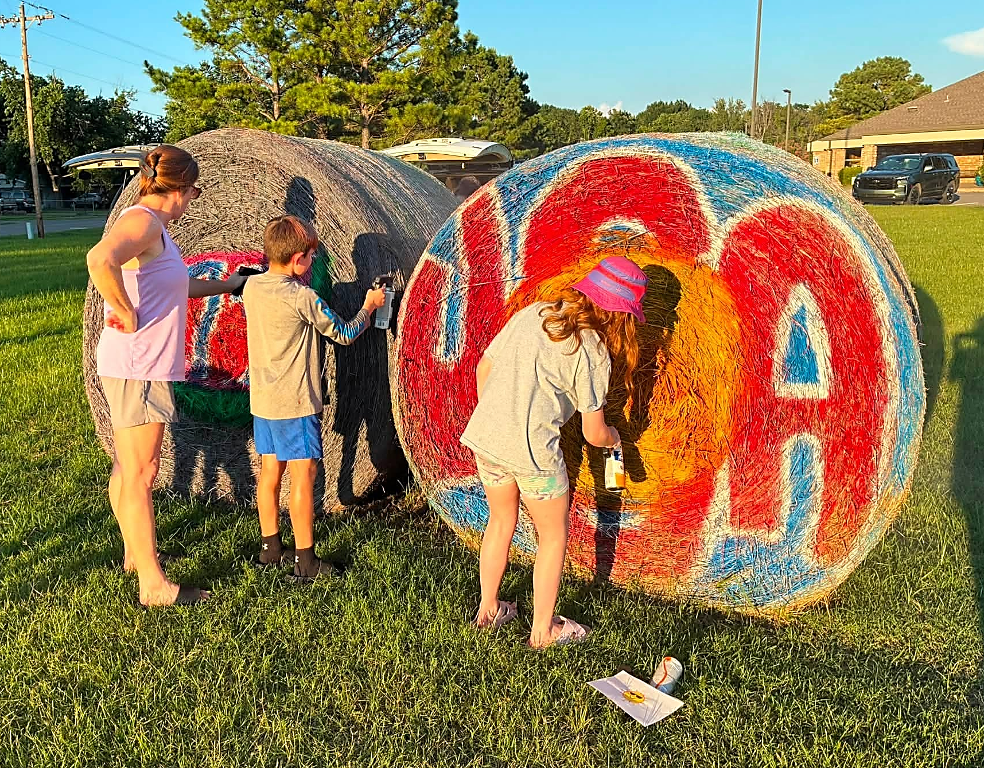
PLAN BEFORE THE ACTIVITY
Plan First: Activities and Transportation
File Form 7 for activities outside the regular club meeting.
Confirm that youth and adult health forms are current and accessible.
Use approved drivers with valid licenses and insurance.
Provide a seat belt for every passenger.
Follow the approved itinerary—no unauthorized side trips.
Confirm appropriate accident or special-activity coverage.
Notes:
Presenter preparation
Be prepared to explain:
When and how the county requires Form 7 to be submitted
Who approves volunteer drivers
How youth and adult health forms are accessed
County procedures for carrying medical information
Available accident and special-activity coverage
Who volunteers contact when plans change
Use current county and state procedures rather than relying on older printed information.
Suggested time: 2 minutes.
Risk management begins before an activity takes place.
Form 7, the Activity and Event Intent Form, communicates the plan to the Extension office. It should be filed for club activities held outside the regularly scheduled club meeting. The form documents the activity, location, transportation arrangements, supervision, and other important details.
As part of the planning process, confirm that current health information is available for both youth and adults when required. This is especially important when participants are being transported, attending an activity away from the regular meeting site, participating without a parent or guardian present, or attending an overnight activity.
Health information can change during the year. Before leaving, volunteers should know who has the forms, how they can be accessed in an emergency, and who should be contacted if medical care is needed. This information should be readily accessible while being protected from unnecessary viewing or disclosure.
Volunteers transporting youth must be certified and approved for the responsibility. They should have a valid driver’s license, an acceptable driving record, automobile liability insurance, and a safe vehicle with a working seat belt for every passenger.
Drivers should follow the approved itinerary and avoid unplanned side trips. They must also carry or have access to the appropriate health information for their passengers.
Teen drivers should be used with great discretion and must follow state law, family expectations, and written event instructions.
The Extension educator should help determine whether the annual group accident policy is sufficient or whether additional special-activity coverage is needed.
If plans change, contact the Extension office before proceeding whenever possible.

Slide 28
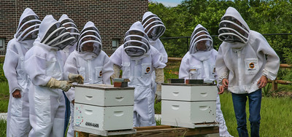
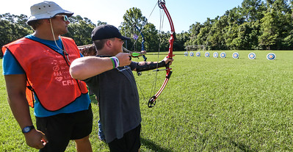
SUPERVISE, RESPOND AND REPORT
Follow Working with Minors requirements.
Follow the assigned chaperone position description.
Avoid one-adult/one-youth situations.
Never leave youth unattended at a meeting or activity site.
Keep medical information readily accessible.
Report and document incidents promptly. (Form 8)
Notes:
Presenter preparation
Review the current Working with Minors requirements, chaperone position descriptions, and county emergency procedures.
Be prepared to explain:
Who volunteers contact during an emergency
How youth are released to parents or designated adults
Where health information is maintained
How and when Form 8 is submitted
Who should receive reports of concerns or unusual incidents
Suggested time: 1-2 minutes.
Working with Minors provides the complete requirements for interacting with and supervising youth. Certified volunteers review these expectations annually. This orientation reinforces several everyday responsibilities.
Follow the position description and instructions provided for the activity. Avoid situations in which one adult is alone with one unrelated youth, including during transportation whenever reasonably possible.
Youth should not be left unattended at a meeting or activity site. An authorized adult should remain until the last participant has been released to an appropriate parent, guardian, or designated person.
For overnight activities, follow all instructions concerning supervision, sleeping arrangements, privacy, and appropriate boundaries.
Keep the appropriate medical information readily accessible so responsible adults can respond quickly in an emergency.
If an accident, injury, concern, or unusual incident occurs:
Attend to immediate health and safety needs.
Contact the appropriate Extension educator, parent or guardian, and emergency personnel as directed.
Record the facts without speculating or assigning blame.
Submit Form 8, the Incident and Accident Report, within three days.
Report concerns promptly, even when you are uncertain whether the situation is serious. The Extension educator will help determine the appropriate next steps.

Slide 29
County Sharing
Know Your County’s
Risk-Management Procedures
Before volunteering, know:
When and how to submit Form 7
Who approves activities and transportation
How health information is accessed
What insurance coverage is available
Where first-aid supplies are located
Who to contact in an emergency
How and when to submit Form 8
Notes:
Pause here to learn more about your county’s risk-management procedures.
Do you have any additional questions regarding information covered today?
County Connection 4 – Risk-Management Procedures
Show: Form 7, Form 8, transportation procedures, health-form process, insurance information, first-aid supplies, and emergency contacts.
Explain: When forms are required, who approves activities and drivers, how health information is accessed, what insurance is available, and how incidents are reported.
Connect: Confirm that the volunteer knows what must be completed before an activity, what information or supplies must be available, and whom to contact when plans change or an incident occurs.

Slide 30
NAME OF PRESENTER
Department of This Slide Goes Last
O | 000.000.0000
C | 000.000.0000
E | name.presenter@okstate.edu
Address Goes Here
City, State
brand.okstate.edu (or other dept. specific URL)

